Slide 1
Introduction to Multimedia
Notes:
‹#›

Slide 2
Table of Content
Definition of multimedia
Classification of media types
Types of Multimedia
Multimedia System
CD-ROM and the Multimedia Highway
Characteristics of multimedia system
Benefits of using multimedia
Problems with multimedia
Multimedia Applications

Slide 3

What is multimedia?
The word multimedia is composed of two parts: the prefix multi and media.
Multi = Plural, more than 1, many
Media = Medium of communication

Slide 4
History
The term “MULTIMEDIA” was first used by BOB GOLDSTEIN in July 1996 to
promote opening of his light works.
In 1970s the term was used to describe presentations consisting of multi-
projector slide shows timed to an audio track.
TAY VAUGHAN declared “Multimedia as combination of text, graphic art,
sound, animation, and video that is delivered by computer.

Slide 5
In common usage, the term multimedia refers to an electronically delivered combination of media including video, still images, audio, text in such a way that can be accessed interactively.
Computers marketed in 1990s were referred to as “MULTIMEDIA
COMPUTERS” because they contained a CD-ROM drive.

Slide 6
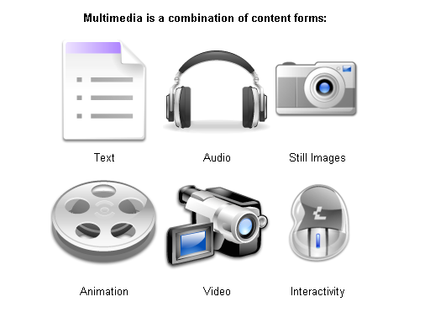
What is multimedia?

Slide 7
What is multimedia?
Definition:
Multimedia is the presentation of a computer application
incorporating media elements such as text, graphics, animations,
audio, and video.
Multimedia is any combination of digitally manipulated text,
graphics, sound,animation and video.
GRAPHIC
TEXT
MULTIMEDIA
VIDEO
AUDIO
ANIMATION

Slide 8
Classification of media types
Time/Space nature
Sound
Video
Animation
Continuous or time-based
Photo
Text
Graphics
Discrete or space-based
Origin
Captured from real world
Synthesized by computer

Slide 9
Captured Versus Synthesized Media
Captured media refers to information types captured from the real world (e.g. Still pictures, moving pictures, and sound).
Synthesized media refers to information types synthesized by the computers (e.g. Text, graphics and computer animation).

Slide 10
Discrete Versus Continuous Media
Discrete media refers to media involving space dimension only (e.g. Still images, text and graphics). Discrete media is also referred to as static media or non-time-based media or non-temporal media or space-based media.
Continuous (time based) media refers to time-based media (e.g. Sound, moving images, and animation). Continuous media is also referred to as dynamic media or time-based media or temporal media.

Slide 11
Multi-sensory system
According to Dr. Albert Mehrabian, a specialist in interpersonal communication at the University of California, says:
Multimedia allows for seeing, hearing and doing (multi-sensory system)
People recall 20% of what they see
40% of what they see & hear
70% of what they see, hear & do

Slide 12
Multimedia- Definitions
Multimedia elements are composed into a project using
authoring tools.
Multimedia Authoring tools are programs that provide the capability for creating a complete multimedia presentations by linking together objects such as a paragraph of text (song), an illustration, an audio, with appropriate interactive user
control.
‹#›

Slide 13
Multimedia- Definitions
By defining the objects' relationships to each other, and by sequencing them in an appropriate order, authors (those who use authoring tools) can produce attractive and useful graphical applications.
To name a few authoring tools
Macromedia Flash
Macromedia Director
Authorware
The hardware and the software that govern the limits of what can happen are multimedia platform or environment
‹#›
Notes:
‹#›

Slide 14
Types of Multimedia
Linear multimedia
Non-Linear multimedia:
Interactive multimedia
Hyperactive multimedia(Hypermedia)
‹#›

Slide 15
Types of Multimedia
Multimedia is linear, when it is not interactive and the users
just sit and watch as if it is a movie.
Multimedia is nonlinear, when the users are given the navigational control and can browse the contents at will.
Multimedia is interactive when the end-user is allowed to control what and when the elements are delivered.
Interactive Multimedia is Hypermedia, when the end-user is provided with the structure of linked elements through which he/she can navigate.
‹#›

Slide 16
Linear VS Non-Linear
LINEAR
A Multimedia Project is identified as Linear when:
It is not interactive
User have no control over the content that is being show to them.
Example:
A movie
A non-interactive lecture / demo show

Slide 17
Linear VS Non-Linear
NON-LINEAR
A Multimedia Project is identified as Non-Linear when:
It is interactive
Users have control over the content that is being showed to them.
Users are given navigational control
Example:
Games
Courseware
Interactive CD

Slide 18
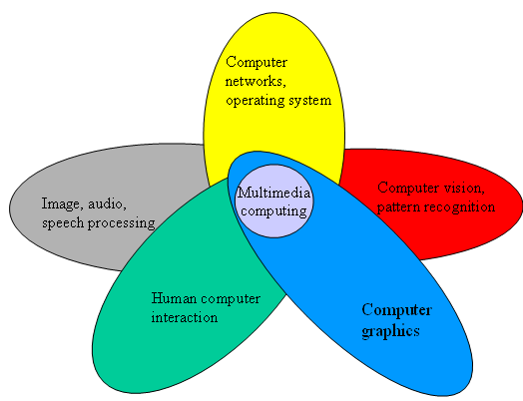
Multimedia is Multidisciplinary

Slide 19
Multimedia System
Following the dictionary definitions, Multimedia system is
any system that supports more than a single kind of media
Implies any system processing text and image will be a
multimedia system!!!
Note, the definition is quantitative. A qualitative
definition would be more appropriate.
The kind of media supported should be considered, rather the number of media
‹#›

Slide 20
Multimedia System
A multimedia system is characterized by
computer-controlled,
integrated production,
manipulation,
storage and communication
of independent information, which is encoded at least through a continuous (time-dependent) and a discrete (time-independent) medium.
‹#›

Slide 21
Introduction to Multimedia -CD-ROM and the Multimedia Highway
The primary media for delivering multimedia projects are:
Compact disc read-only (CD-ROM).: Red Laser
640MB
Digital Versatile Disc (DVD): Blue Laser

Slide 22
Compact Disc Read-Only (CD-ROM)
CD-ROM is the most cost-effective distribution medium for multimedia projects.
It can contain up to 80 minutes of full-screen video or sound.
CD burners are used for reading discs and converting the discs to audio, video, and data formats.

Slide 23
Digital Versatile Disc (DVD)
Multilayered DVD technology increases the capacity of current optical technology to 18 GB.
DVD authoring and integration software is used to create interactive front-end menus for films and games.
DVD burners are used for reading discs and converting the disc to audio, video, and data formats.

Slide 24
Introduction to Multimedia -The Multimedia Highway
Telecommunication networks are global and information elements will link up online as distributed resources on a data highway.
Copper wire, glass fiber, and radio/cellular technologies also serve a means for delivering multimedia files across a network.
Examples: Full-text content from books and magazines; Street maps of any city; feature movies are displayed at home; real-
time news reported from anywhere on earth; lectures from
participating universities.

Slide 25
Characteristics of Multimedia System
They must be computer-controlled. User is able to view, hear, and see using a Multimedia
PC System.
They are integrated. At least one discrete and one continuous media
combined for information presentation and sharing.

Slide 26
…continued
The information they handle must be represented
digitally. Consists of various form of media i.e. text, graphics,
audio, video, and animations; created, stored, processed,
and transmitted DIGITALLY.
The interface to the final user may permit interactivity. User is able to navigate, interact, create, and
communicate.

Slide 27
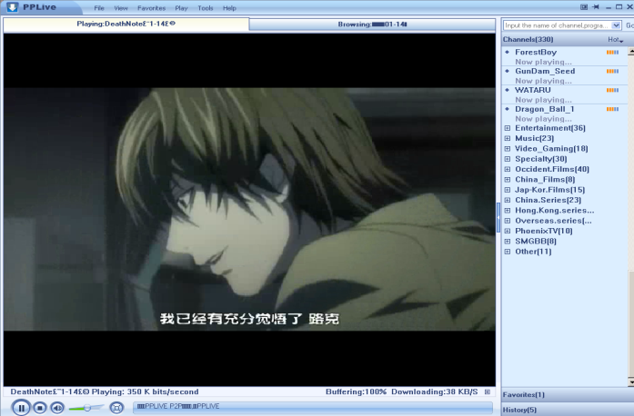
Benefits of using multimedia in software
Ease of use
User friendly, increase user’s effectiveness
Intuitive Interface
Allows user to determine functions of an application by their
own intuition
Immersive Experience
- Software application takes over the entire computer screen,
allows user to focus on application

Slide 28
Benefits of using multimedia in software
Self-paced interaction & better retention
- allows information processing at one’s own pace
Better understanding
- simultaneous presentation of different media provides richer & broader range of information.
Cost effectiveness
- less training, less technical support

Slide 29
Problems with Multimedia
Investment costs
- multimedia involves high volume of content
- expensive copyright and royalty
Technical barriers (accessibility issues)
- upgrade IT & PC infrastructure
Sociopsychological barriers
- Generation gap
- Learning rates
- Learning in group/individual
Legal problems
- Copyright

Slide 30

Where to use multimedia ?
Business
Government
Education
Broadcasting & Entertainment
Research & Development
Health

Slide 31

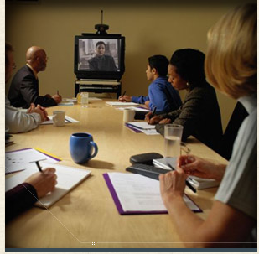
Business
Interactive Multimedia Merchandising
Online-shopping
Virtual shopping / home shopping
Desktop Videoconferencing
Due to the high cost of transportation and the large amount of employee time spent traveling to meetings, videoconferencing is on the rise.

Slide 32
…continued
Multimedia Travel Systems
These systems enable the travel agents to show their customers about where they will travel, what will be their accommodation like, and what they will be able to do at their destinations.
Real Estate
Multimedia systems enable buyers to visit hundreds of properties virtually, view on screen photos of homes, inspect floor plans, see street maps, and study neighborhood demographics.

Slide 33
…continued
Corporate Training
Many corporations have used multimedia to reduce training cost and improve employee productivity.
Advertising and Electronics Brochures
The electronic brochure is an advertising and marketing tool that usually consists of single diskette or CD-ROM sent to targeted audiences. Corporations are also beginning to offer shareholders annual reports on CD-ROM.

Slide 34
…continued
Politics
Multimedia in general and internet in particular are playing a big role in politics and virtual campaigning where every political candidate contesting in an election has a web site.
Consumer Information
Multimedia based CD-ROMs are available which
contains government information on a wide variety of
topics: government forms, list of government offices in
each state, tax preparation etc.

Slide 35

Education
Computer Aided Learning
To assist student through simulation for better understanding such as volcano eruption, corrosion, language pronunciation, etc.
Virtual Campus
Learning takes place in a virtual classroom using video conferencing and online lecture so that students all around the world can attend.

Slide 36
Broadcasting and Entertainment
Electronic catalogue
Product features and descriptions are advertised through web, CD and mobile devices.
Interactive Movie
Viewers can decide the direction of the plot of the movie and camera angle.
On-demand News or movies
News, movies and TV series can be watched on demand through web and mobile devices.

Slide 37

…continued
3D or animated movies
Movies created through advance 3D technology and animation techniques.
Video Games
Advances in the field of multimedia have led to more attractive video and computer games being available now in the consumer market.

Slide 38
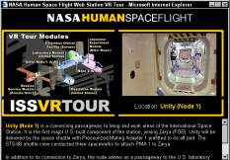
…continued
Virtual Reality
Virtual Reality refers to the use of a computer to immerse the user into a simulated experience that it seems real. Virtual reality systems often use special hardware to enhance the experience, including visual displays.
Cyber Sports
Cyber Sports is the use of virtual reality to provide computer users with a realistic sports experience. Two new interactive virtual reality devices let you “Swing” and “Hit” balls at your PC.

Slide 39
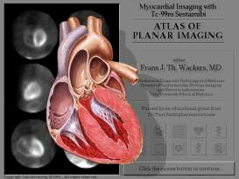
Medicine
Virtual Surgery
Virtual surgery authoring system has been created for producing surgical training simulation.
Surgeons can use 3-D images created from magnetic resonance imaging (MRI) scans of the human body to practice complicated procedures such as brain tumor removal and reconstructive surgery.

